Slide 1
Notes:
Good Morning Everyone and thank you for joining today’s call. I’m pitching my proposal for a thesis on supporting the specification of fairness requirements under Dr. Qusai Ramadan.

Slide 2
Content
Introduction and Motivation
State of the Art
Why should fairness be considered in Requirements Engineering?
Why is specifying fairness requirements challenging?
Research Questions
Methodology
Work Packages and Schedules
Notes:
Contents provides a brief overview of the topics we will be covering in this meeting.

Slide 3
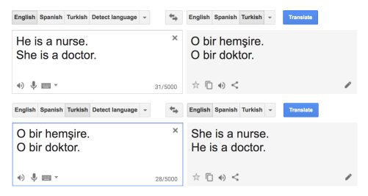

Introduction and Motivation
Software fairness refers to the ethical and unbiased treatment of individuals or groups by software systems.
As technology becomes increasingly integrated into various aspects of society, ensuring fairness in software is essential to mitigate biases, discrimination, and inequality.
Decision-making software refers to computer programs or systems designed to analyze information, evaluate options, and make choices, often aiming to support or automate decision-making processes across various domains.
Google Translate
Amazon Recruiting Software
Notes:
Firstly, we need to understand that there are multiple definitions of fairness such as contextual fairness, proportional fairness or distributive fairness to name a few but for this thesis, we will focus on Equality. Equality-based fairness emphasizes on treating all individuals or groups equally, regardless of their differences or circumstances. It aims to ensure that everyone has the same opportunities, rights, and treatment without discrimination or favoritism.
Today, as technology continues to permeate various aspects of our society, from healthcare to finance, education to criminal justice, the ethical and unbiased treatment of individuals or groups by software systems has never been more crucial because we find ourselves at a point where the decisions made by algorithms and artificial intelligence impact our lives in profound ways.
Fairness encompasses various dimensions, including race, gender, socioeconomic, and disability-related fairness, among others. It is about ensuring that the systems that govern our lives treat every individual fairly and justly, regardless of their background or identity.
Decision-making software, in particular, plays a pivotal role in shaping outcomes across diverse domains. Whether it's analyzing data to inform medical diagnoses, evaluating candidates for job opportunities, or predicting recidivism rates in criminal justice systems, these software systems wield immense power in influencing our lives. And unchecked software systems can have adverse implications of biases, discrimination, and inequality that arise from it.
Many companies are collecting data nowadays and this presents the risk of discrimination based on protected characteristics. For example….

Slide 4
State of the Art
Early phases
Later phases
Requirements
Engineering
System
Design
Module
Design
Implementation
Unit
Testing
System Testing and Verification
Detecting discrimination
Mitigating discrimination
Explaining algorithmic decisions
Understanding fairness
Development phase
Literature
Support
Benefits from
Notes:
This image represents the Software Development Lifecycle. We will see how fairness is being tackled in SDLC. As you can see, the first three stages of requirements engineering, system design module design are considered as the early phases whereas implementation, unit testing, system testing and verification are considered as the later phases. To detect discrimination, it can be done starting from the module design phase and can be carried on in the later phases as well.
During the module design phase, the developers carefully analyze the algorithms and decision-making processes implemented within each module and more attention is paid to identifying potential sources of bias and discrimination, such as the selection of features, training data, and decision rules. As the development progresses to implementation, unit testing, and system testing phases, you have various other testing procedures that help evaluate the fairness of the software. This involves conducting tests to identify disparities in outcomes across different demographic groups and assessing the impact of algorithmic decisions on marginalized populations.
Now, There are also approaches to mitigate discrimination and these approached start in the module design phase and can also last in the implementation phase but these approaches do not exist in the testing phases because the goal is to avoid them before we can get to the testing phase.
There are some approaches that are used for explaining algorithmic decisions in general; this usually happens in the unit testing and system testing & verification phase. There is very little work that is being done in the phase that pertains to fairness; for example where they define what fairness means and what are the different fairness measures and so on.
And each of these three things so to say, detecting discrimination, mitigating discrimination and explaining algorithmic decisions could greatly benefit from understanding what fairness constitutes, in detail. And from this image we can also make out that fairness has been overlooked in the first 2 phases. So, my goal for this thesis is to support the specification of fairness requirements in the requirements engineering phase of the software development lifecycle. So, I am not looking to the system design and will focus particularly on the requirements engineering phase.

Slide 5
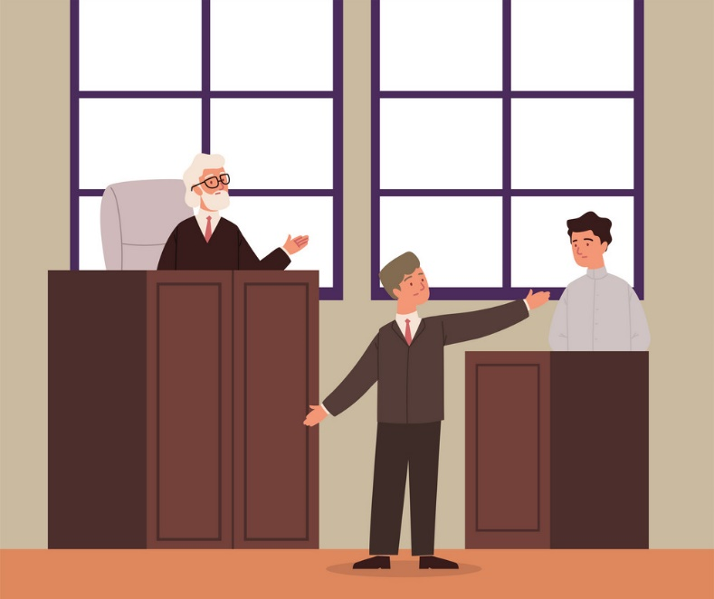
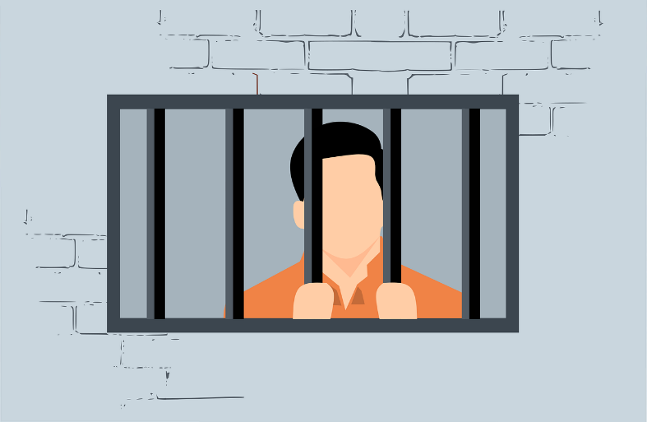
Why should fairness be considered in Requirements Engineering?
To Avoid The Formalism Trap
Example: COMPAS (Correctional Offender Management Profiling for Alternative Sanctions)
COMPAS is a widely used algorithmic tool in the criminal justice system aimed at assessing the risk of reoffending or failing to appear in court among defendants.
COMPAS analyzes various factors such as criminal history, age, employment status, and social environment to generate a risk assessment score.
The purpose of COMPAS is to assist judges and parole boards in making informed decisions about pretrial release, sentencing, and parole supervision
Notes:
So, Let’s move on to why should fairness be considered in requirements engineering?
The answer to this question is to avoid the formalism trap. To understand this, we have the following example.
COMPAS software was a pivotal algorithmic tool that was used in the American criminal justice system, which helps in assessing the risk of reoffending or failing to appear in court among defendants. This algorithmic tool takes into consideration a lot of factors ranging from criminal history and age to employment status to generate a risk assessment score. The overaall goal of this tool is to help the judges in making more informed decisions.

Slide 6
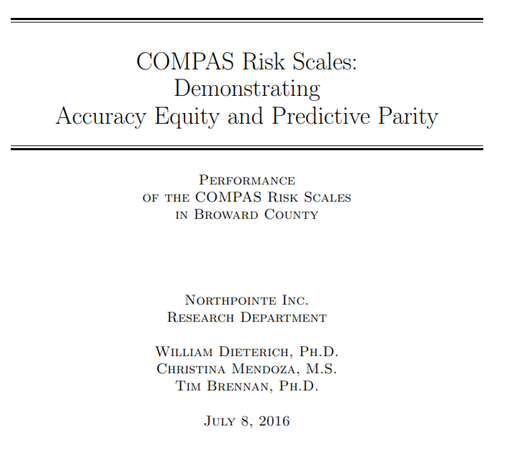
Why should fairness be considered in Requirements Engineering?
ProPublica's investigation shed light on issues of fairness and accountability in the criminal justice system.
COMPAS developers fulfilled their goal of creating a decision-making tool but faced criticism regarding potential biases and lack of transparency.
Consulting legal experts or professionals with domain knowledge before development could have validated requirements and facilitated consensus among stakeholders.
Establishing clear requirements and consensus could have enabled a more transparent and accountable development process, helping to identify and address biases effectively.
COMPAS
Journalists at ProPublica demonstrated that a certain measure of fairness (equality of error rates) was violated.
vs
Notes:
Pro publica conducted an investigation which proved that the compass software violates certain fairness measures such as equality and error rates. They felt people from the marginalized community we're getting higher risk assessment scores compared to others.
Later on, the founder of the compass software came out with a statement stating that the software is fair with respect to accuracy, quality and something els.
This issue occurred due to the lack of clear requirements. If there were clear requirements that were defined then ProPublica could have taken pressed charges against the developers of the compass software for unjust treatment of individuals. Since clear requirements were not specified, both the parties involved were partially right and as they judged the software based on their own requirement, which was not mutually agreed upon.
If the requirements were specified clearly with the consultation of a legal expert who has prior knowledge of this subject, it would have been easier to judge the requirements rather than the software because the software is built on top of the requirements. This way the developers can be very certain that they're developing the right software without having to worry of the legal consequences or redeveloping the software again. Also establishing clear requirements would improve the transparency of the software which will help in identifying and addressing bias more efficiently.

Slide 7
Why is specifying fairness requirements challenging?
The lack of structural conceptual model
Due to the lack of a glossary, there is no standardized definitions for fairness and its related concepts.
No structured framework for understanding fairness concepts.
Increases the risk of misinterpretations and inconsistent application hence leading to ambiguity.
Fairness has multiple interpretations and it is essential to have universally accepted definitions to avoid experts unintentionally working from different perspectives. For example, “Statistical Parity” and “Demographic Parity” can be used interchangeably to describe equal representation among demographic groups.
Notes:
However, specifying fairness requirements can be challenging for 2 reason in particular.
Firstly, one of the primary challenges arises from the lack of a conceptual model. Without a standardized glossary, there absence of universally accepted definitions for fairness and its related concepts. This absence leads to ambiguity which makes it more difficult to establish clear criteria for fairness in software systems.
Additionally, the absence of a structured framework for understanding fairness concepts further adds to this challenge. The lack of a systematic approach makes it challenging to define, and address fairness requirements effectively.
Sometimes, there may be multiple interpretations of fairness to describe the same thing. With various perspectives on what constitutes fairness, non-experts may unintentionally operate from different viewpoints, leading to misinterpretations and inconsistent application

Slide 8

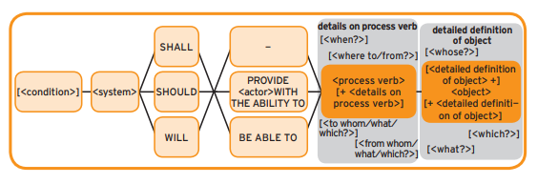
Why is specifying fairness requirements challenging?
The lack of a customized requirements engineering template that allows for specifying fairness requirements.
Requirement 1: The COMPAS software should be able to predict the likelihood of reoffending for individuals.
Requirement 2: The COMPAS software should be designed to ensure fairness by treating all individuals equally
Non-Expert Requirements Engineer
Functional MASTER Template
Notes:
The second reason is the lack of a customized requirements engineering template that allows for specifying fairness requirements
for example, if a non expert requirements engineer is designing functional requirements for a particular software using the functional master template, he or she may define the requirements as shown in these examples.
The first requirement states that the COMPAS software should be able to predict the likelihood of reoffending for individuals. This statement lacks specificity regarding how the prediction should be made and what factors should be considered in the prediction process. Without clear definitions of terms such as "likelihood of reoffending" and "individuals," the requirement becomes ambiguous. Additionally, the requirement does not specify how the accuracy or effectiveness of the prediction should be measured, making it unverifiable.
The second requirement mandates that the COMPAS software should be designed to ensure fairness by treating all individuals equally. While fairness is a considered, the requirement lacks clarity on what constitutes fairness and how it should be achieved. Without clear definitions of fairness and equality, the requirement becomes ambiguous and open to interpretation. Different stakeholders may have different views on what fairness entails, leading to subjective interpretations and potential conflicts and without objective criteria for assessing fairness and equality, it is difficult to determine whether the requirement has been fulfilled.

Slide 9
Research Questions
RQ2: How can the relationships between the identified concepts be effectively expressed and structured in a conceptual model for specifying fairness-related requirements in software?
RQ4: How can the applicability of the developed conceptual model and MASTER template be evaluated through a real-world case study?
RQ3: How can the MASTER template be extended effectively to incorporate explicit fairness conditions in software requirements?
RQ1: What are the fundamental concepts essential for the specification of fairness-related requirements in software development?
Notes:
RQ1: What are the fundamental concepts essential for the specification of fairness-related requirements in software development?
The Objective of this research questions is to identifies the core concepts pertaining to fairness and It aims to delve into the foundational ideas and principles related to specifying fairness-related requirements.. Additionally, this rq will aim to develop a glossary of fairness and its related concepts.
RQ2: How can the relationships between the identified concepts be effectively expressed and structured in a conceptual model for specifying fairness-related requirements in software?
The Objective of this research question is to understand how the identified concepts from RQ1 can be interconnected and expressed in a conceptual model. It will address the challenge of creating a comprehensive framework that can guide the specification of fairness-related requirements in software.
RQ3: How can the MASTER template be extended effectively to incorporate explicit fairness conditions in software requirements?
Objective: Analyze the existing structure and components of the MASTER template to identify potential gaps or limitations in addressing fairness-related requirements. Propose and develop enhancements to the MASTER template, to explicitly address fairness considerations in software requirements specification.
RQ4: How can the applicability of the developed conceptual model and MASTER template be evaluated through a real-world case study?
Objective: Select a diverse and representative real-world case study that involves software development scenarios with potential fairness implications across different domains or contexts. Apply the developed conceptual model and extended MASTER template to the selected case study, ensuring comprehensive coverage of fairness-related requirements and considerations.

Slide 10
Methodology (Completed)
RQ1: What are the fundamental concepts essential for the specification of fairness-related requirements in software development?
Methodology:
Systematic Literature Review – Conduct a systematic review of the literature using Mendeley for citation management.
Glossary Development – Synthesis of findings from literature review to develop a glossary of fairness related concepts using tools such as Microsoft Word or Google Docs

Slide 11
Systematic Literature Review
Keywords
Software, Fairness, Discrimination, AI, and Requirements
Search Phrase
(("Abstract":Software ) OR ("Abstract":AI) OR ("Abstract":Requirements ) ) AND (("Document Title":Fair*) OR ("Document Title":Discriminat* ))
Sources
IEEE, ACM, Springer

Slide 12
Systematic Literature Review
Inclusion Criteria
Include studies that focus on fairness or discrimination in the context of software development.
Include academic papers and publications available in reputable peer-reviewed journals or conference proceedings.
Include studies published within the last 10 years (2014 to present) to ensure the inclusion of recent and relevant literature.
Include studies published in English to ensure the ability to comprehend and extract relevant information.
Exclusion Criteria
Exclude studies focusing solely on general ethics or fairness in fields unrelated to software development.
Exclude non-academic sources like blog posts, opinion pieces, or forum discussions that may lack academic rigor.
Grey literature sources such as unpublished reports, theses, dissertations, and non-peer-reviewed materials.
Studies published in other languages other than English
Publications outside the defined publication timeframe (2014 – Present)

Slide 13
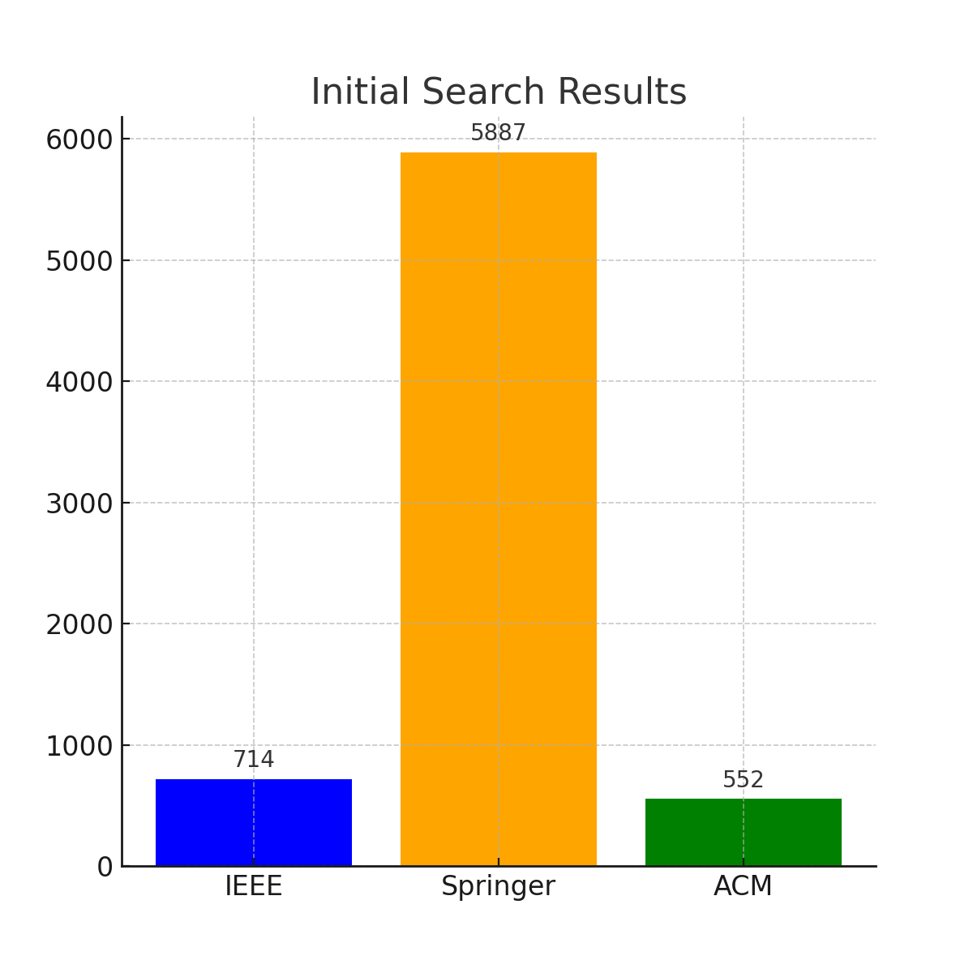
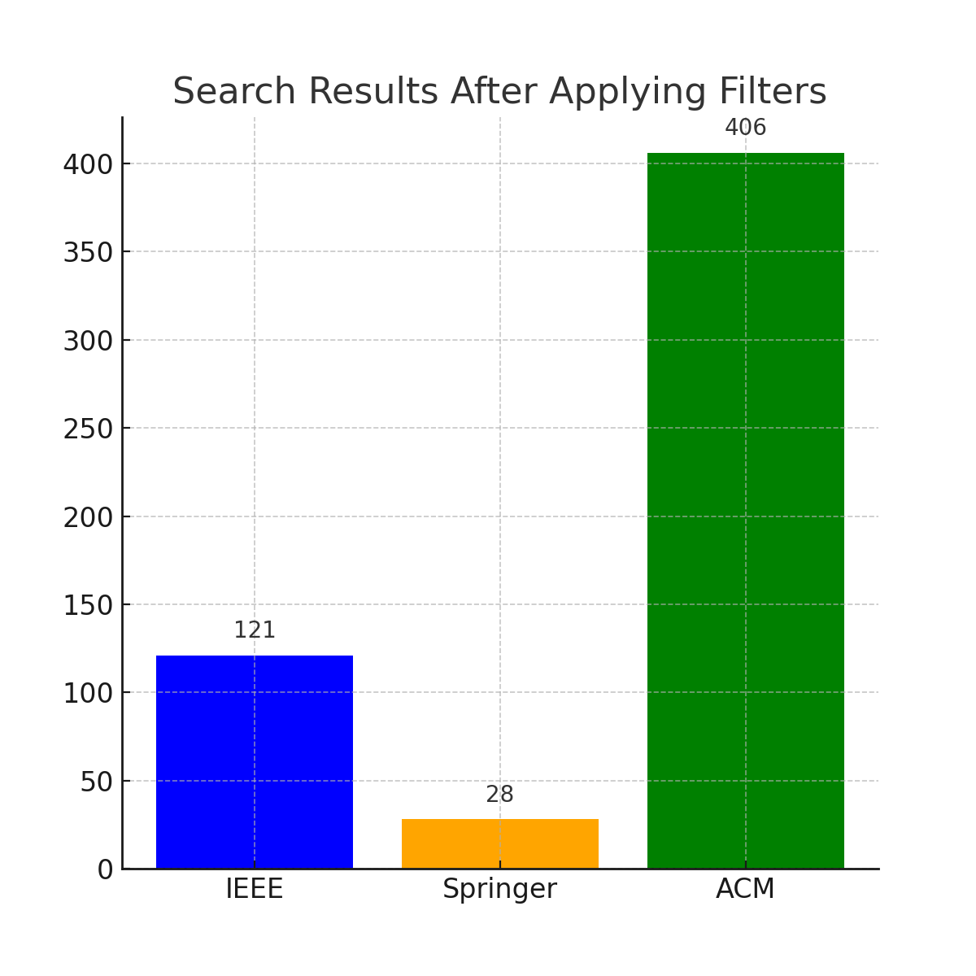
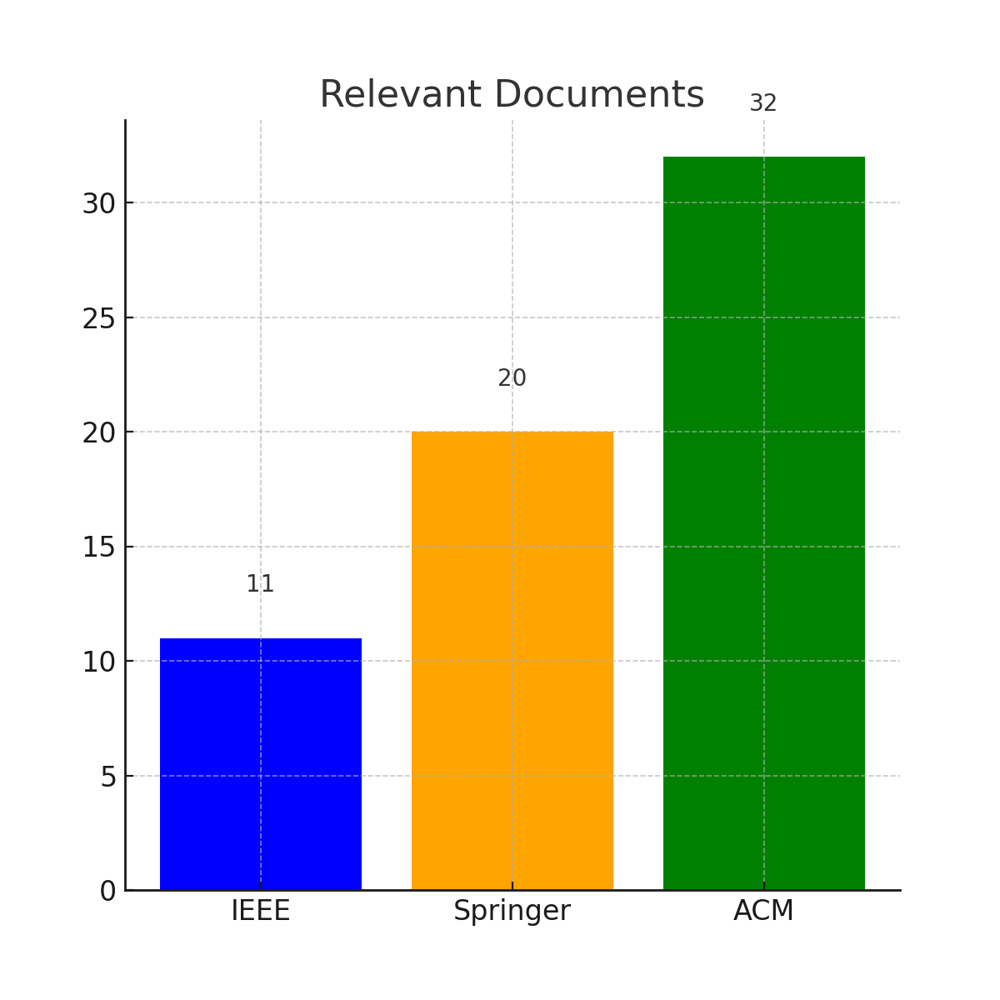
Systematic Literature Review
Study Selection
Initial Search Results
Search Results After Filters
Relevant Documents

Slide 14
Information Extraction
Created a template with the following columns to extract the information from relevant papers.
Title
Author
Publication
DOI
T0 Fairness Mentioned
T1 Authors Understanding of Fairness
T2.a Motivation for fairness
T2.b Laws and Standards
T3 Application Domain
T4.a Fairness Measures
T4.b Protected Characteristics
T4.c Subjects
T5 Type of Discrimination
T6.a Mention of Proxy
T6.b Measurement of Proxy
T7 Type of Work
T8 Phase
T9 Type of Paper
T10 Threats of Violating Fairness
T11 Fairness Trade-offs
T12.a Quantitative Measurement and Metrics
T12.b Qualitative Measurement and Metrics
T13 Other Terms

Slide 15
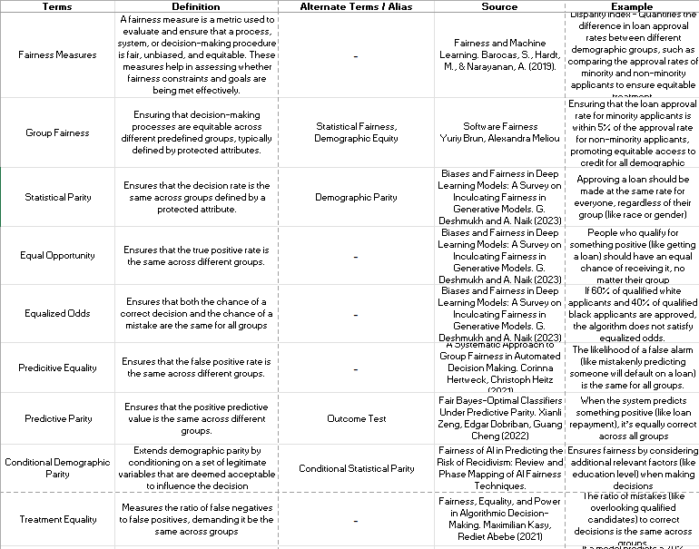
Glossary

Slide 16
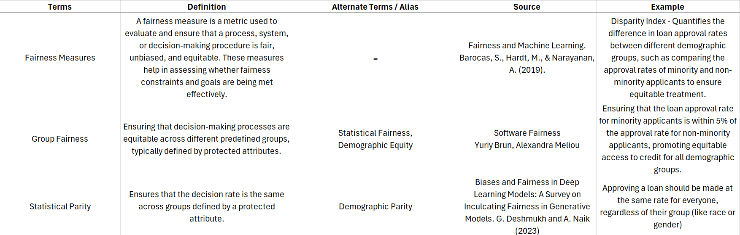
Glossary
Fairness Goals
Fairness Requirement
Fairness Techniques
Fairness Constraints
Fairness Audits
Fairness Measures
Group Fairness
Statistical Parity
Equal Opportunity
Equal Opportunity
Equalized Odds
Predicitive Equality
Predictive Parity
Conditional Demographic Parity
Treatment Equality
Calibiration
Individual Fairness
Protected Attributes
Anti-Protected Attributes
Proxy Discrimination
Exploratory Variables
Counterfactual Fairness
Data Subject
Threat
Vulnerabilities
Risk
Stakeholder Involvement
Subgroup Fairness
Intersectional Fairness
Causal Fairness
Temporal Fairness
Robust Fairness
Fairness Through Awareness

Slide 17
Methodology (Completed)
RQ2: How can the relationships between the identified concepts be effectively expressed and structured in a conceptual model for specifying fairness-related requirements in software?
Methodology:
Conceptual Mapping – Visualization and mapping of relationships between identified fairness-related concepts using MindMeister.
Model Design – Design a conceptual model based on the mapped relationships and dependencies using draw.io.
Iterative Refinement – Iteratively refine the initial conceptual model.

Slide 18
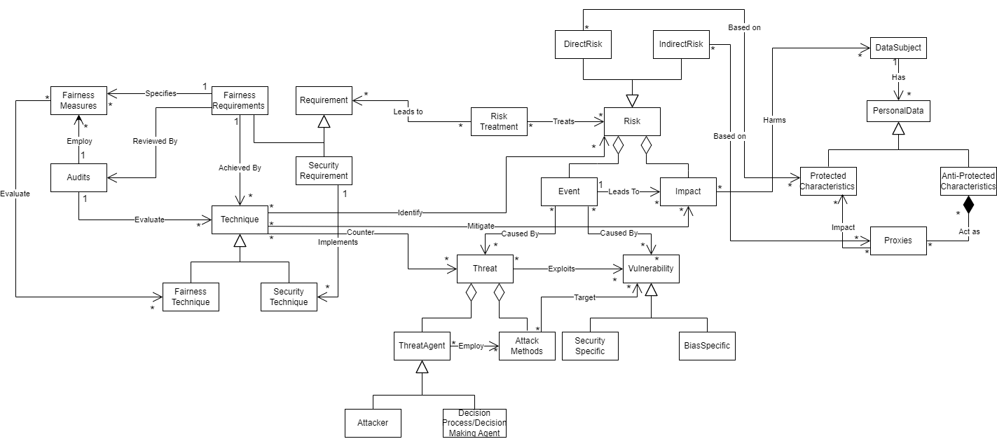
Conceptual Model

Slide 19
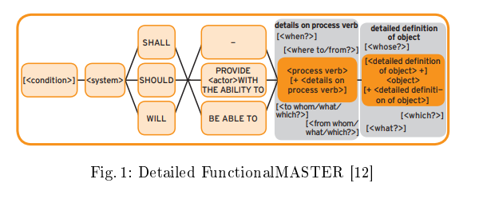
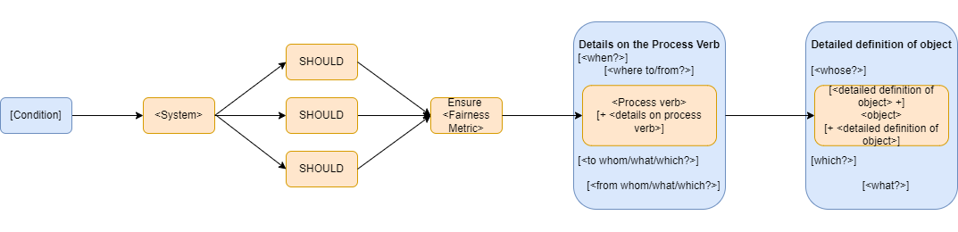
Methodology (To do)
RQ3: How can the MASTER template be modified effectively to incorporate explicit fairness conditions in software requirements?
Methodology:
Template Analysis – Analyze the structure and content of the existing MASTER template.
Gap Identification – Identify gaps or deficiencies in the MASTER template concerning the inclusion of fairness-related requirements.
Extension Design – Proposal of modifications or additions to the MASTER template using draw.io.
Extended Master Template

Slide 20
Methodology (To do)
RQ4: How can the applicability of the developed MASTER template be evaluated through a real-world case study?
Methodology:
Validation Testing – Testing the conceptual model and extended MASTER template against real-world scenarios and use cases.
Feedback Collection – Gathering feedback from peers and supervisors on the applicability and effectiveness of the conceptual model and extended MASTER template.
Analysis – Analysis of collected feedback to identify strengths, weaknesses, and areas for improvement using tools such as Microsoft Excel or Google Sheets.
Documentation – Document the validation findings and recommendations for future adoption and implementation using tools such as Microsoft Word or Google Docs.
Extended Master Template
Case Studies
Hiring Practices in Tech Companies
Loan Approval Systems in Financial Institutions
Online Advertising Algorithms

Slide 21
Thank You

